Slide 1

PRESENTED BY: PRANAV KATARIA, YASH YADAV & PIYUSH GOYAL
THE POWER
OF
PRODUCTION QUALITY
"QUALITY PRODUCTION IN PODCASTS ISN'T JUST ABOUT SOUND, IT'S ABOUT CRAFTING AN IMMERSIVE EXPERIENCE THAT CAPTIVATES LISTENERS AND FOSTERS MEANINGFUL ENGAGEMENT."

Slide 2

TABLE OF CONTENTS
- Introduction
- Objectives
- Conceptual Framework
- Research Methodology
- Key Findings

Slide 3

Introduction

Slide 4

The Power of Quality Podcasting
Explore how high-quality production impacts podcast success and engagement.

Slide 5

The Impact of Quality in Podcast Production
QUALITY EQUIPMENT ENHANCES LISTENER EXPERIENCE
Investing in high-grade headphones and microphones is essential.
EDITING IMPROVES OVERALL SOUND QUALITY
Editing software is pivotal for removing background noise, ensuring clarity.
ENGAGING CONTENT RETAINS AUDIENCE'S ATTENTION
Balancing music and voice levels is crucial for an enjoyable experience.
CONSISTENT SOUND LEVELS ENHANCE PROFESSIONALISM
Clear audio and engaging discussions build listener loyalty.

Slide 6
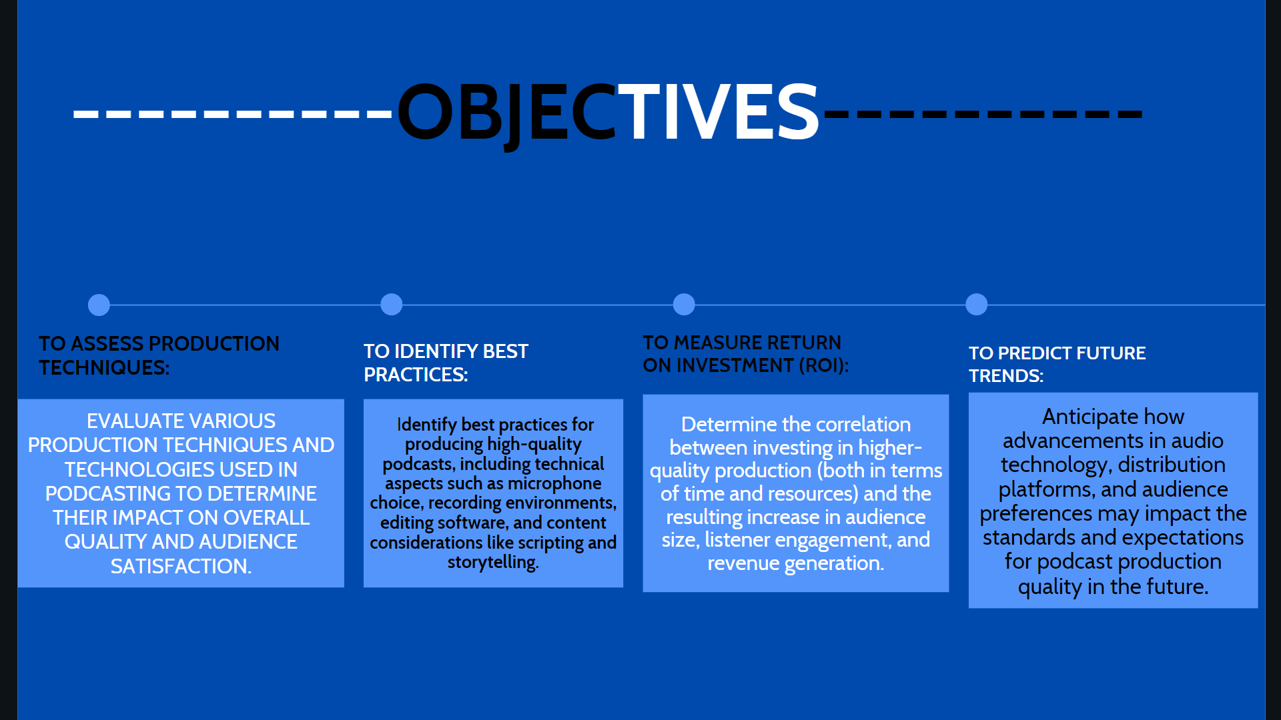

Slide 7


Slide 8
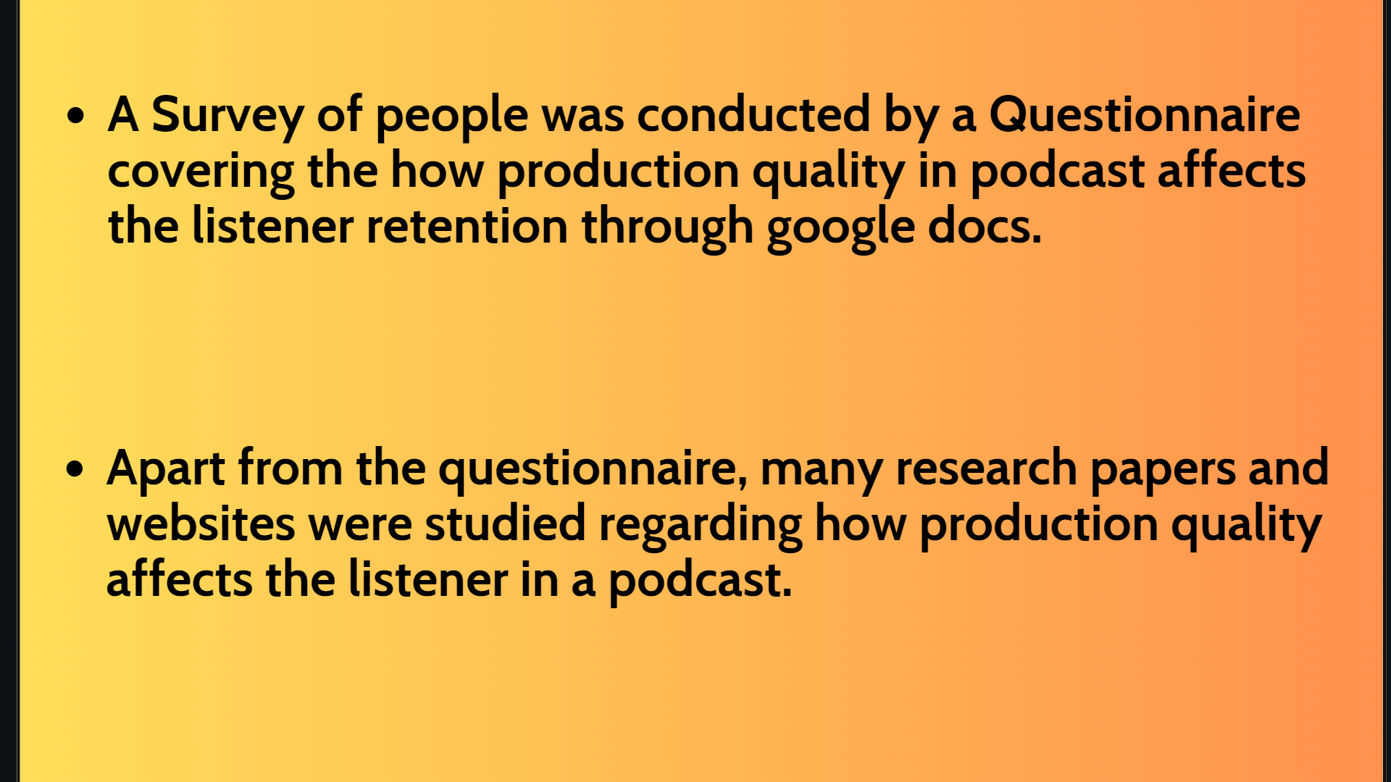
HTTPS://WWW.RESEARCHGATE.NET/PUBLICATION/43120483_TOWARDS_GUIDELINES_ON_EDUCATIONAL_PODCASTING_QUALITY_PROBLEMS_ARISING_FROM_A_REAL_WORLD_EXPERIENCE

Slide 9
Key
Findings!

Slide 10

People Generally do not tend to listen to podcasts with low Production Quality.
If the podcast has poor production quality and if it has some background noises almost 60 % of people avoid listening to it even if the content is very Interesting

Slide 11
People generally prefer to listen to podcasts using their audio devices like earphones ,tws and even on speakers .
People also pay attention to sound effects , background music used along with the content in Podcasts.
They believe that visual elements like camera angles , editing , transistions enhance the enjoyment of a podcast

Slide 12
People tend to recommend others podcasts with high production quality even if the content isn’t our usual preference
Engagement is enhanced by incorporating polls and live Q/A
Good Production Quality such as High quality microphone, the use professional mixing and mastering techniques increase the listener retention and engagement by 50%
Almost 60 % of people think of subscribing and recommending a Podcast with high Production quality

Slide 13

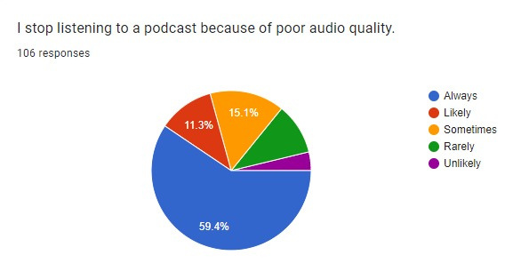
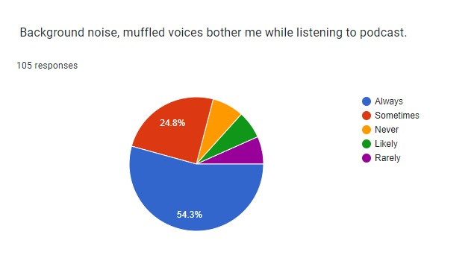
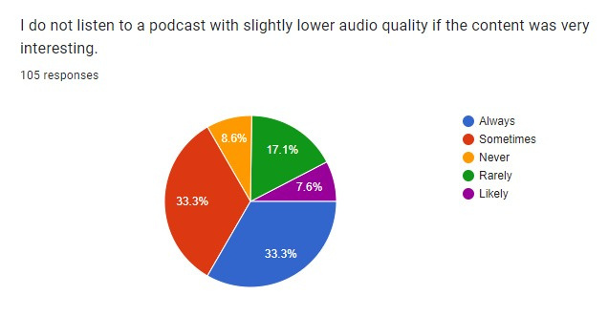

Slide 14

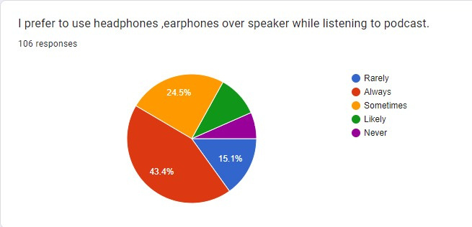
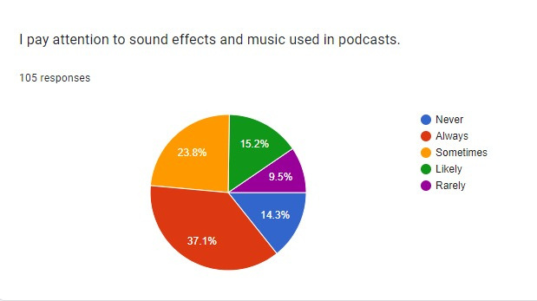
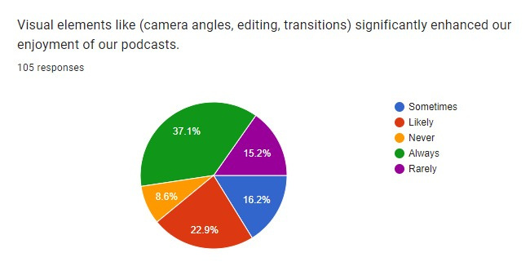

Slide 15
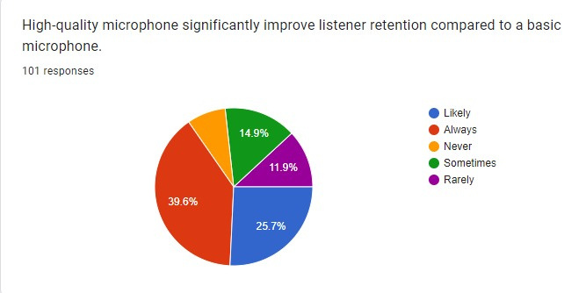
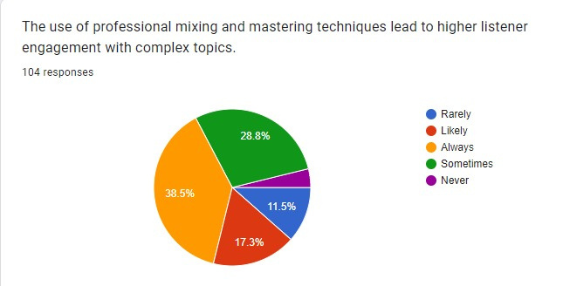
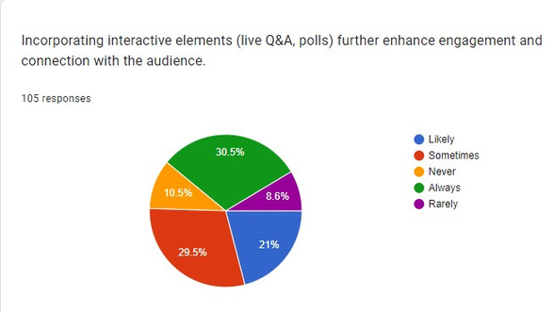

Slide 16
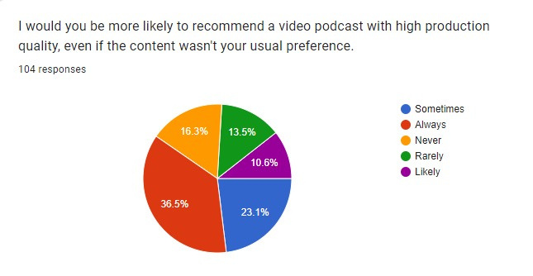
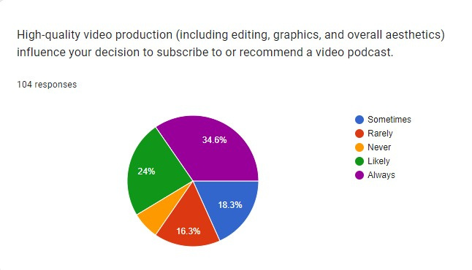

Slide 17
THANK YOU

